Slide 1
Optimization of print parameters to reduce warpage in fused deposition modeling
Pranav Addepalli

Slide 2
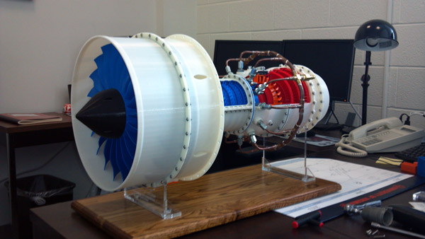
Background
3D printing is crucial for many industries
Construction
Medicine
Robotics
Aerospace
Defense
http://www.3dprinterworld.com/article/3d-printing-enables-university-students-become-aerospace-manufacturers

Slide 3
Background
Fused Deposition Modeling
Most common printing method
Melts a thermoplastic filament repeatedly
Polylactic Acid
Most common filament
Made from renewable lactic acid
https://www.3dnatives.com/en/fused-deposition-modeling100420174/

Slide 4
Background
FDM prints layer by layer, creating thermal cycles
Cooling → Contraction → Mechanical stress
Heating → Expansion → Mechanical stress
Greatest stress in corners
This is called warpage
https://www.3dhubs.com/talk/t/adhesion-and-upward-warping-problems/4334

Slide 5
Thermal properties are important to understand!

Slide 6
My Project
Studying multiple print parameters
Wall thickness
Layer height
Infill percentage
Infill height
Effect on temperature distribution
PLA discs during printing process
https://www.dddrop.com/wp-content/uploads/2018/02/3D-printen-stevige-infill.jpg

Slide 7

My Project
Optimizing values for the print parameters
Deep Learning
Visualize, model, find trends
in spatiotemporal temperature data and heat flow trajectories
Find the best parameters and print test discs

Slide 8
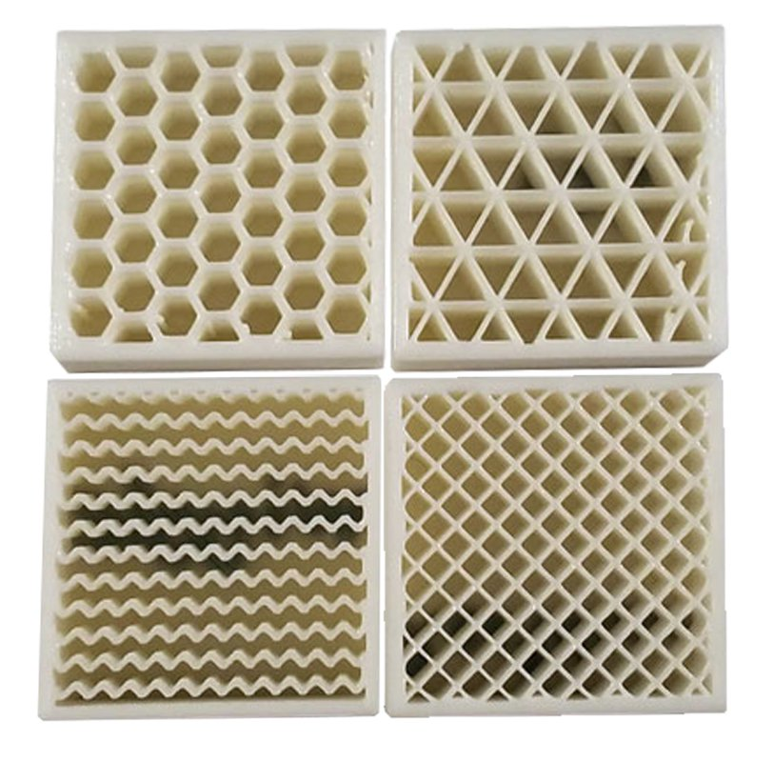
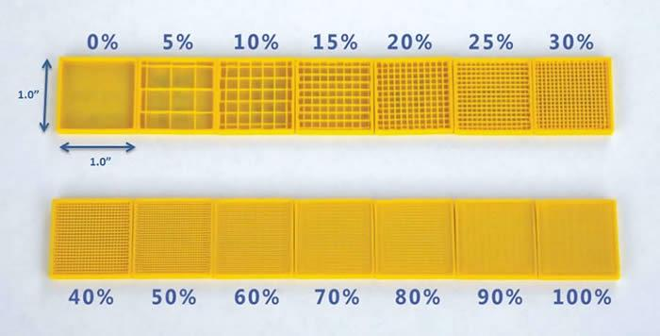
Variables
Infill type (grid vs. triangular)
Infill percentage (10%, 20%, 30%)
https://3dprinting.com/tips-tricks/how-to-choose-an-infill-for-your-3d-prints/
http://tcadsolutions.com/3dprinting.html

Slide 9
Variables
Wall thickness (0.4mm vs. 0.8mm)
Layer height (0.1mm vs. 0.2mm)
http://archive.fabacademy.org/fabacademy2017/fablabvigyanashram/students/132/assignments/assignment%205.html
https://medium.com/3d-printing-in-o-p/iv-slicing-72a9515f44bc

Slide 10
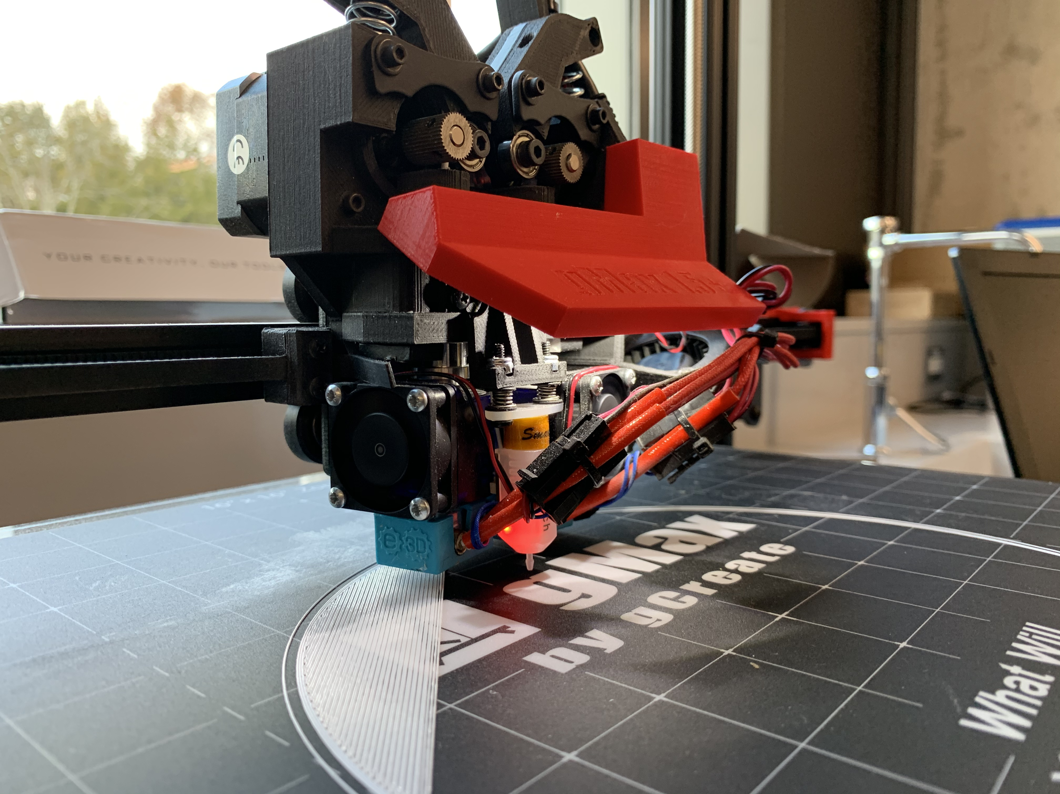
Materials
NTC Thermistors
Hatchbox PLA
Arduino Uno R3 (with breadboard)
NVIDIA Jetson Nano
gCreate gMax 1.5 XT+

Slide 11
5 Phase Procedure
Design
Data Collection
Modeling
Optimization
Final Tests

Slide 12
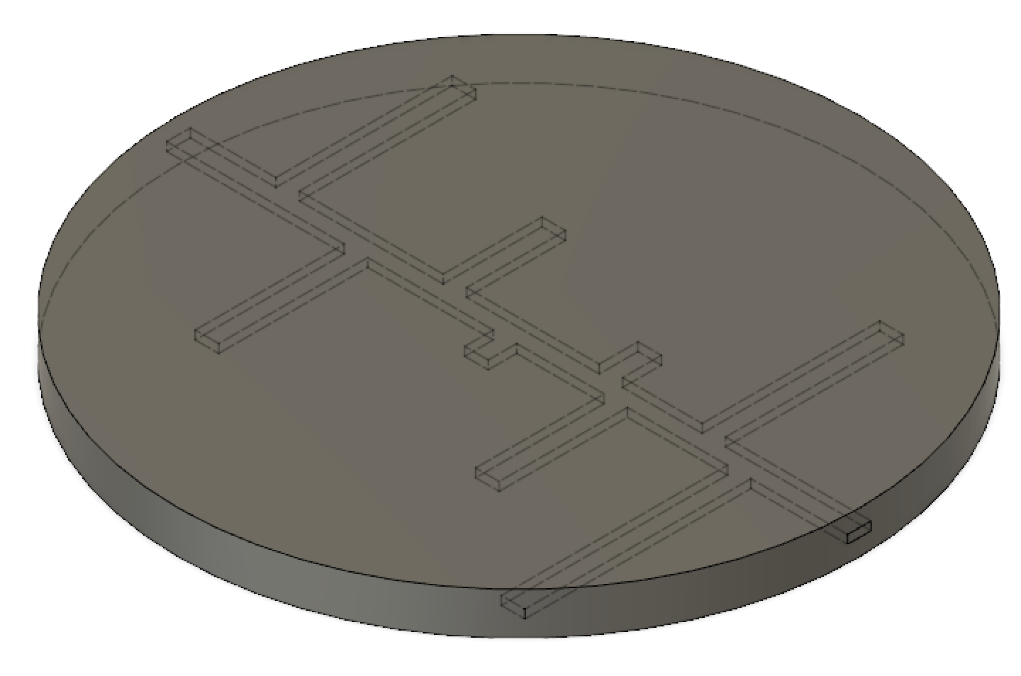
1) Design
Design CAD models in Fusion 360
8 inch diameter
0.5 inch thickness
Channels along circles for thermistors
Slice disc with different print parameters in Ultimaker Cura

Slide 13
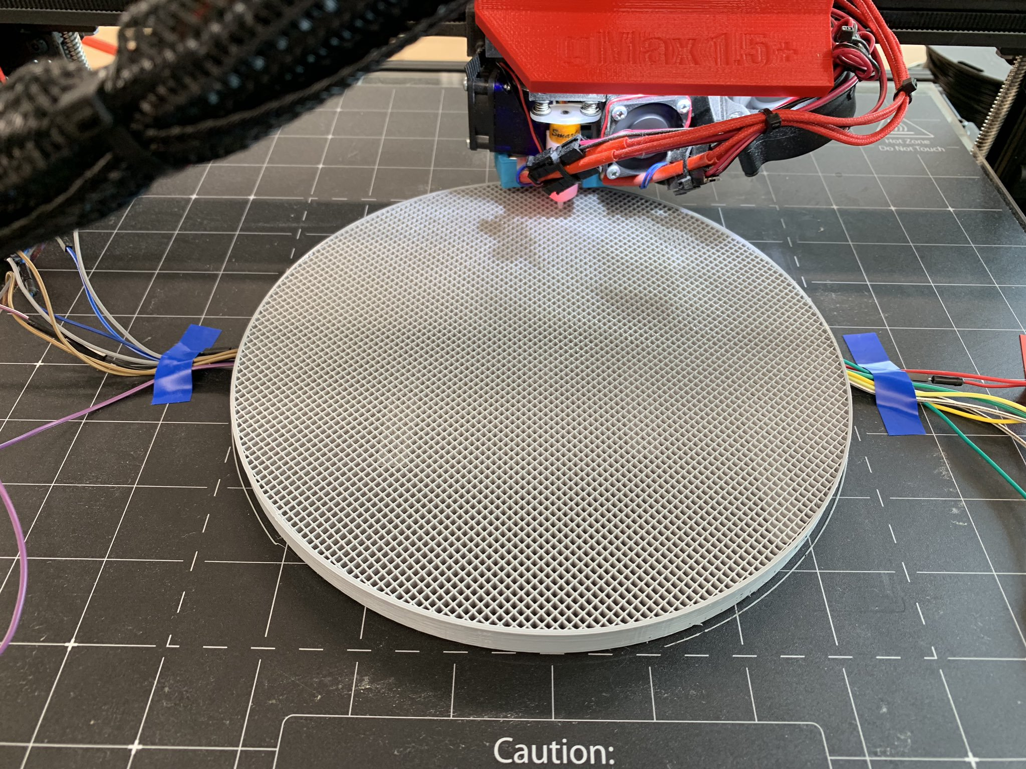
2) Data Collection
Halfway through the printing process:
Embed thermistors
Connect to Arduino
Begin recording temperature

Slide 14
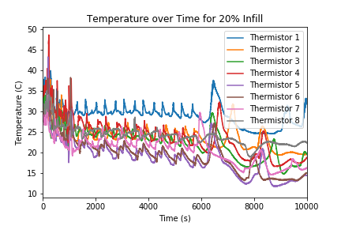
3) Modelling
Similar to the data from junior year
More parameters and tests → can find trends in the data
Deep learning (ANNs, DTW, Getis-Ord GI*, etc.)
Heat flow trajectory analysis

Slide 15
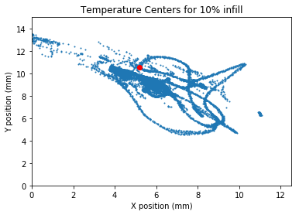
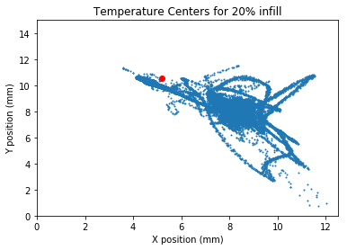
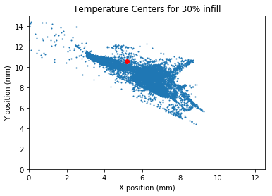

Slide 16
4) Optimization
Method will be refined later
Optimization, simply: reducing the value of a cost function by changing some inputs
Inputs: print parameters
Cost function f : Euclidian distance from geometric center to a weighted temperature center at time t
(a basic framework for it)
https://justinbradley.unl.edu/cps-co-optimization

Slide 17
4) Optimization
The full process I use depends on what the data looks like, but…
Assuming f is:
non-convex (not always above its tangent),
non-smooth (gradient can be undefined at some points),
noisy (in blue),
well-conditioned (scale of input values is known)
and numerically unknown,
(a more complex framework for it)
We have a very difficult problem.
https://scipy-lectures.org/advanced/mathematical_optimization/index.html

Slide 18
4) Optimization
But we can still approach this!
The Newton Method:
uses local quadratic approximations to find which direction to “jump” to find the minimum
uses the gradient and the Hessian
The Broyden-Fletcher-Goldfarb-Shanno algorithm (BFGS) approximates the Hessian iteratively
(a complicated framework for it)
https://ardianumam.wordpress.com/2017/09/27/newtons-method-optimization-derivation-and-how-it-works/
This gives us a quasi-Newton method for our optimization.

Slide 19
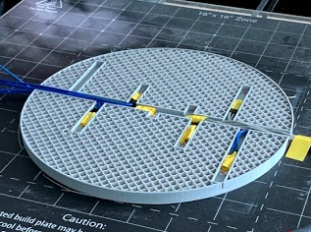
5) Final Tests
Will print discs with the optimized parameters
Will study the cost function and look for a statistically significant decrease

Slide 20
Current Progress

Slide 21
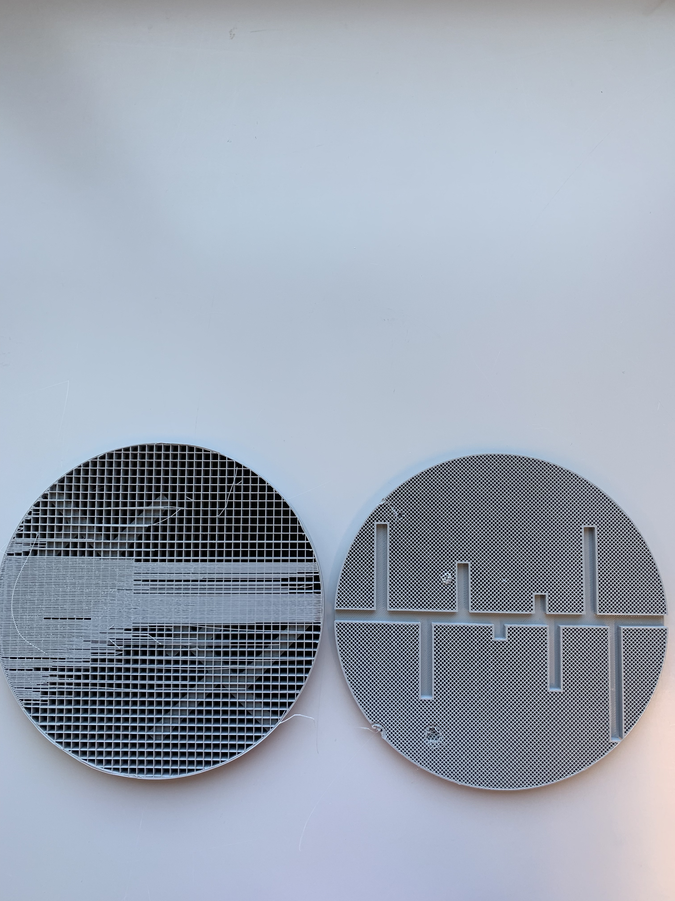
Junior Year Conclusions and Results
Increasing infill percentage increases the uniformity of the temperature distribution and theoretically reduces warpage
Designed a process to collect spatiotemporal temperature data during 3D printing
Designed a weighted temperature centers method to analyze data

Slide 22
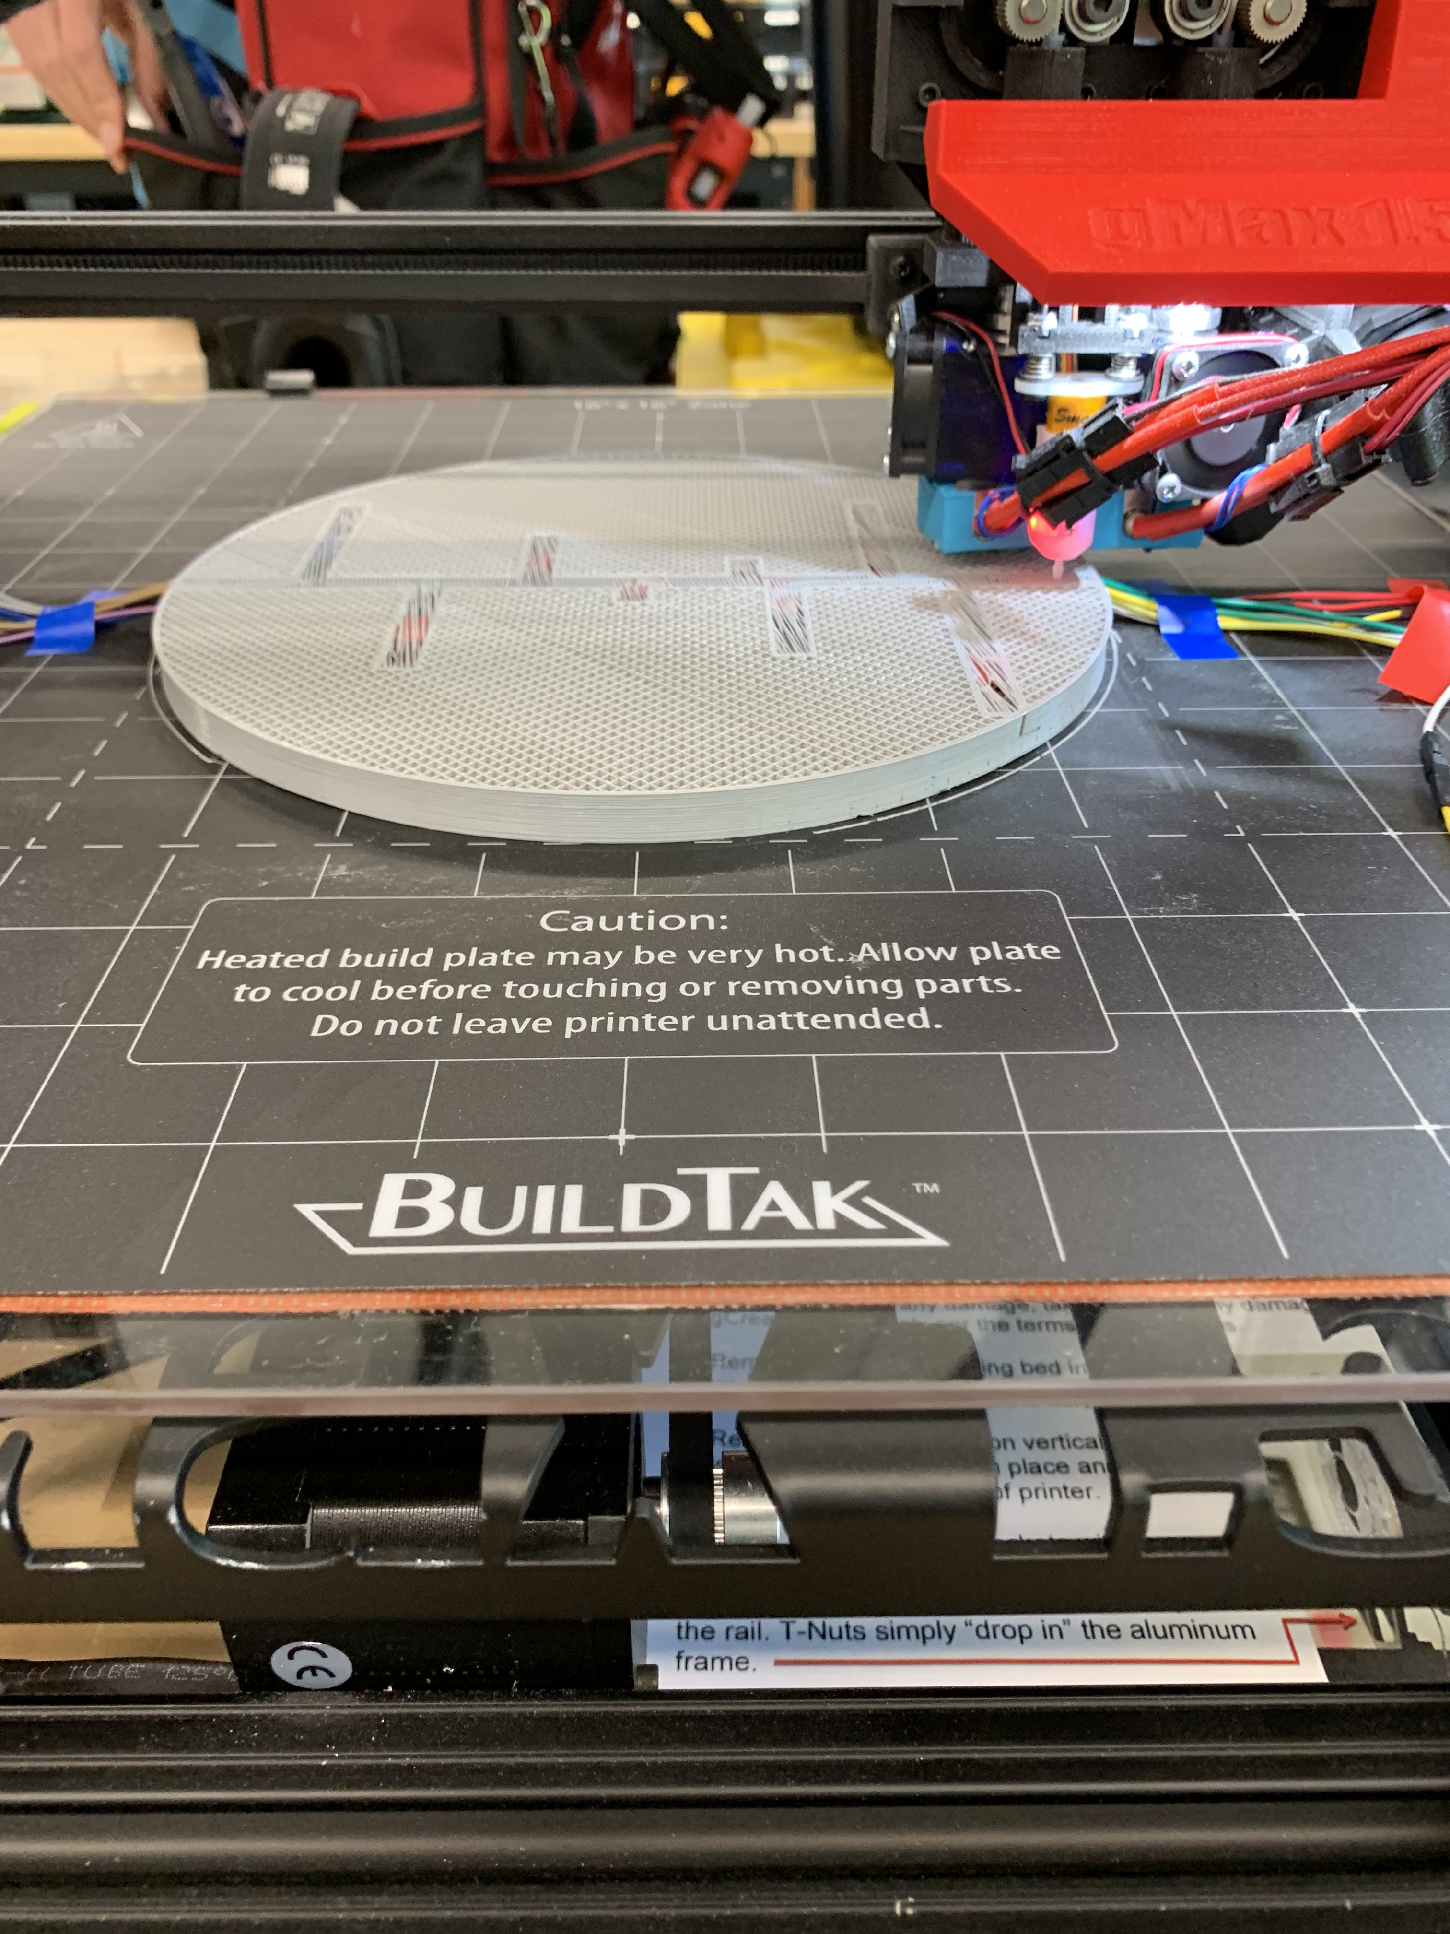
Senior Year Progress
Completed Phase 1 (Design)
Working on Phase 2 (Data Collection)
Completed multiple subtasks for future phases
built Arduino-thermistor circuit
explored junior year data
developed program for modelling data in Python
started setting up Jetson
fixed gCreate printer’s z-axis problem

Slide 23
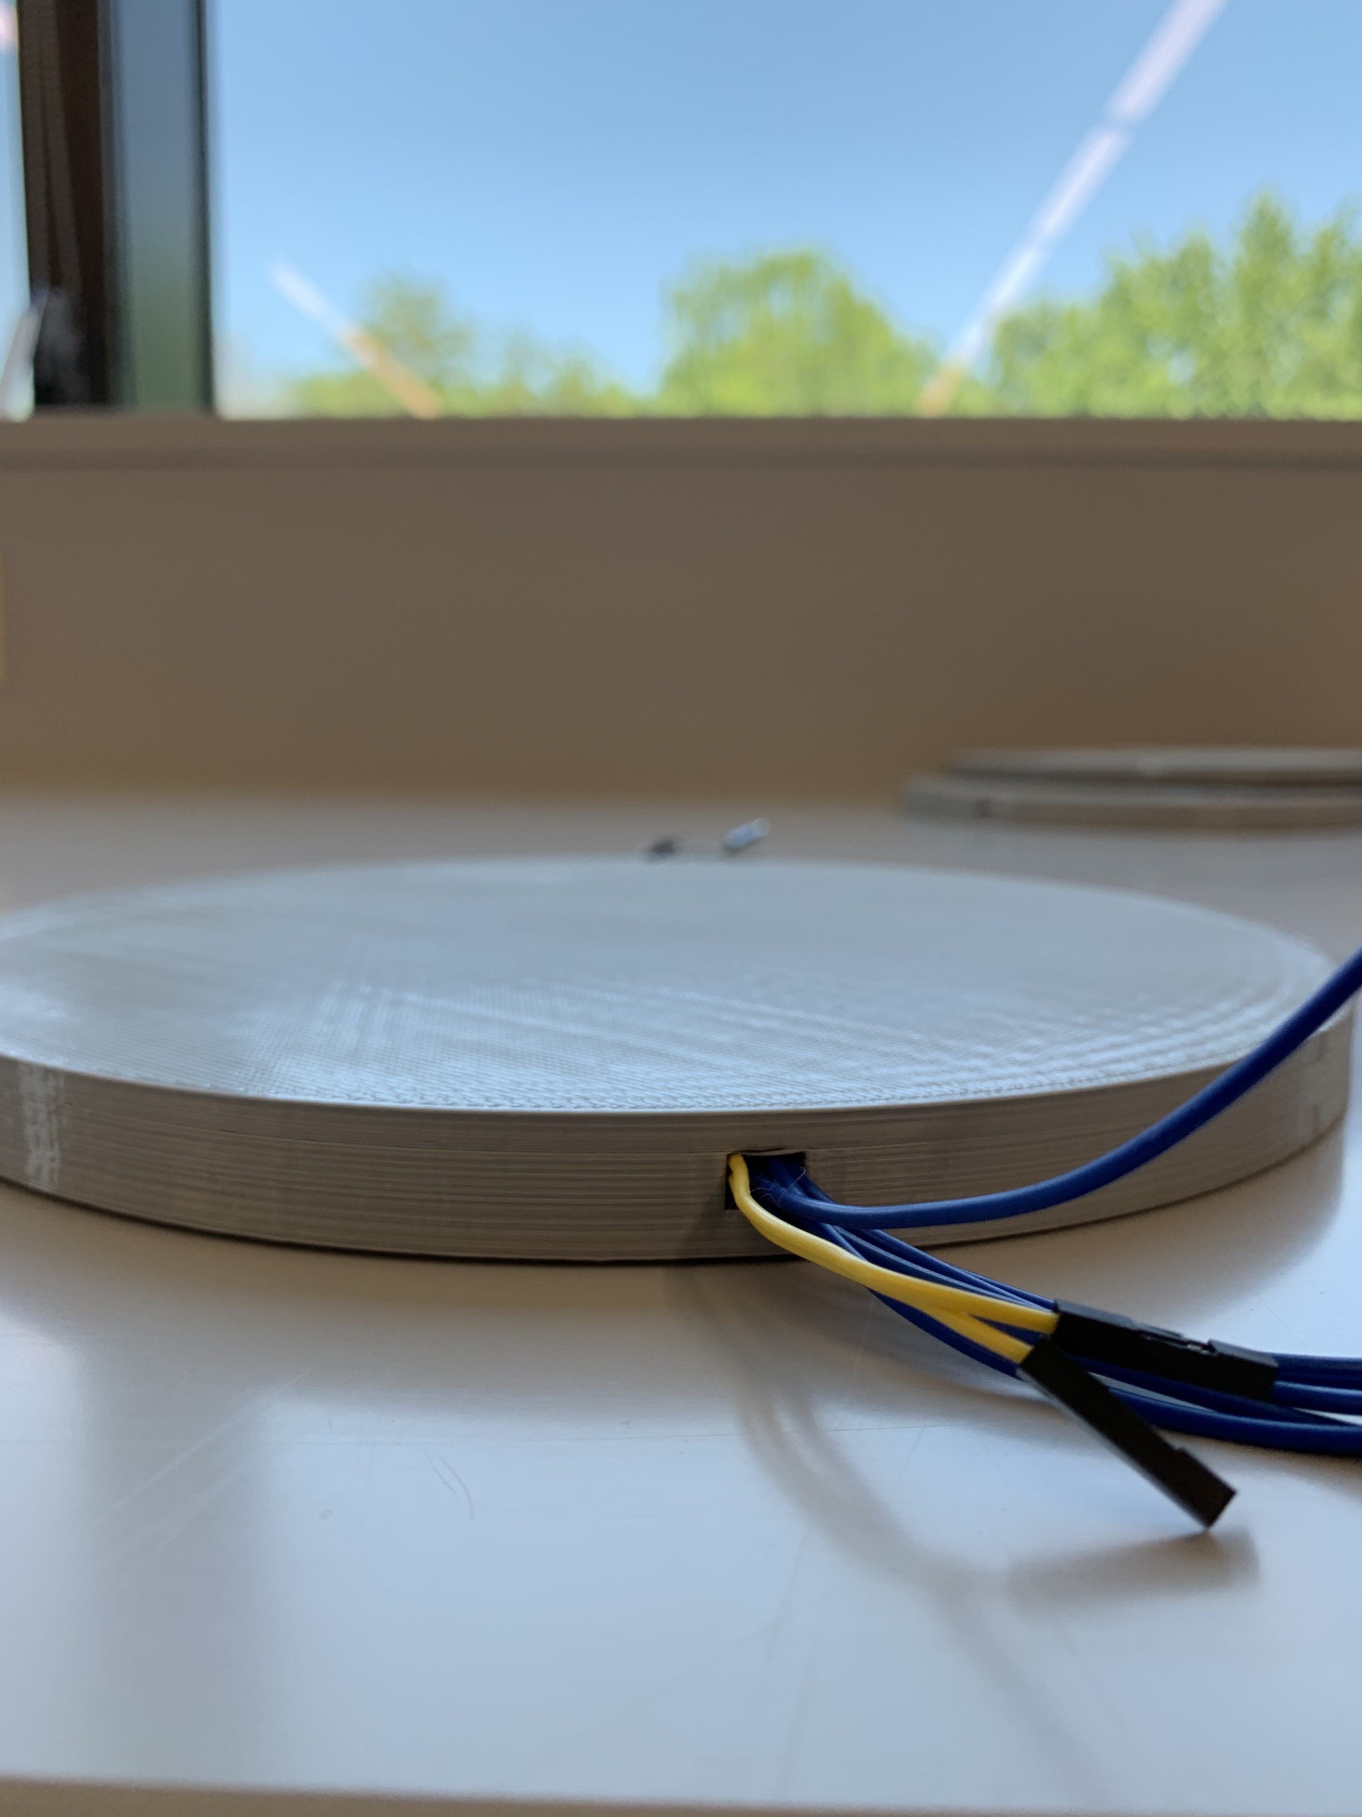
Future Work
Complete Phase 2 (data collection) and Phase 3 (modelling) by March 1st
Enough for the engineering side of the project
Can draw conclusions
Complete Phase 4 (optimization) and Phase 5 (final tests) by Symposium in May
Computational modeling side of the project
Will support/oppose my conclusions

Slide 24
References
Zhang, J., Wang, X. Z., Yu, W. W., Deng, Y. H. (2017). Numerical investigation of the influence of process conditions on the temperature variation in fused deposition modeling. Materials & Design, 130, 59-68. doi:10.1016/j.matdes.2017.05.040
Deng, C., Kang, J., Shangguan, H., Hu, Y., Huang, T., Liu, Z. (2018). Effects of hollow structures in sand mold manufactured using 3D printing technology. Journal of Materials Processing Technology, 255, 516-523. doi:10.1016/j.jmatprotec.2017.12.031
Vaughan, N. & Gabrys, B. (2016). Comparing and combining time series trajectories using Dynamic Time Warping. Procedia Computer Science, 96, 465 – 474. doi:10.1016/j.procs.2016.08.106
Studer, M & Ehrig, F. (2014). Minimizing part warpage in injection molding by optimizing wall thickness distribution. Advances in Polymer Technology, 33. doi:10.1002/adv.21454

